Slide 1
COMP507 IT Project Management Cost Management
Notes:
Last week’s learning useful to this lecture: normal dist, sd/sigma, MOE

Slide 2
What is Cost?
Cost is a resource sacrificed or foregone to achieve a specific objective or something given up in exchange
Usually measured in monetary units like dollars that must be paid to acquire goods and services

Slide 3
What is Project Cost Management?
Project cost management includes the processes required to ensure that the project is completed within an approved budget
Planning cost management: use organizational policies, procedures, and documentation for cost planning
Estimating costs (business-level, i.e. portfolio level): developing an approximation or estimate of the costs of the resources needed to complete a project
Determining the budget (project-level): allocating the overall cost estimate to individual work items to establish a baseline for measuring performance
Executing the budget for the project
Controlling costs: controlling changes to the project budget

Slide 4
Basic Principles of Cost Management: basic concepts
Most members of an executive board better understand and are more interested in financial terms than IT terms; they need to be able to present and discuss project information in both
Profits: revenues minus expenditures
Profit margin: ratio of profits to revenues
Life cycle costing: considers total cost of ownership, or development plus support costs, for a project
Cash flow analysis: determines estimated annual costs and benefits for a project and resulting annual cash flow

Slide 5
Basic Principles of Cost Management: types of costs and benefits
Tangible costs or benefits are those costs or benefits that an organization can easily measure in dollars
Intangible costs or benefits are costs or benefits that are difficult to measure in monetary terms
Direct costs are costs that can be directly related to producing the products and services of the project
Indirect costs are costs that are not directly related to the products or services of the project, but are indirectly related to performing the project
Sunk cost is money that has been spent in the past; when deciding what projects to invest in or continue, you should not include sunk costs

Slide 6
Basic Principles of Cost Management: additional concepts
Learning curve theory states that when many items are produced repetitively, the unit cost of those items decreases in a regular pattern as more units are produced
Reserves are dollars included in a cost estimate to mitigate cost risk by allowing for future situations that are difficult to predict
Contingency reserves allow for future situations that may be partially planned for (sometimes called known/predictable unknowns) and are included in the project cost baseline
Management reserves allow for unpredictable future situations (sometimes called unknown/unpredictable unknowns)

Slide 7
Planning Cost Management
The first step in project cost management is planning how the costs will be managed throughout the life of the project
The project team uses expert judgment, analytical techniques, and meetings to develop the cost management plan
Cost management plan includes:
Level of accuracy
Units of measure: man-hour? man-day? FTE: full time equivalent?
Organizational procedure links
Control thresholds: a specified amount of variation allowed before action needs to be taken, such as 10 percent of the baseline cost
Rules of performance measurement (such as CPI, SPI in EVM)
Reporting formats
Process descriptions (how-to)

Slide 8
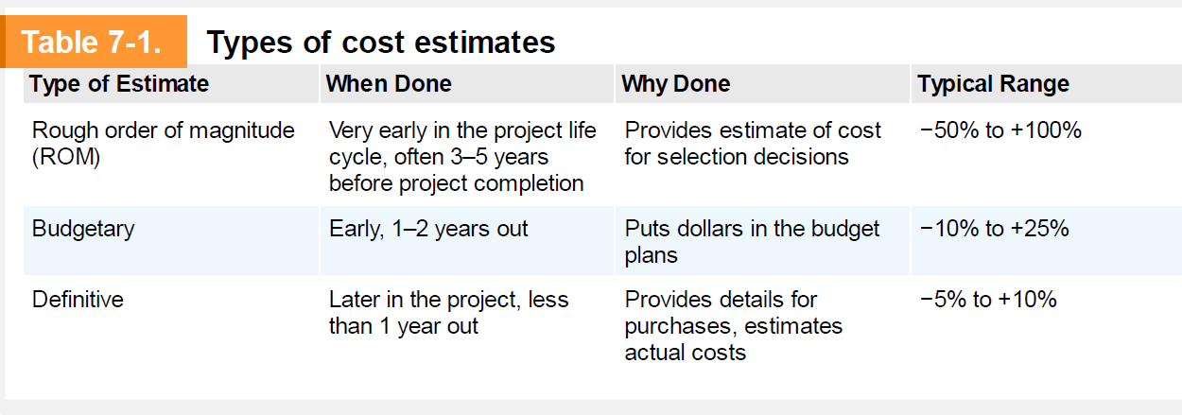
Estimating Costs: Types of Cost Estimates

Slide 9
Cost Estimation Tools and Techniques
Analogous or top-down estimates
Use the actual cost of a previous, similar project as the basis for estimating the cost of the current project
Bottom-up estimates
Involve estimating individual work items or activities and summing them to get a project total
Three-point estimates
Involve estimating the most likely, optimistic, and pessimistic costs for items
Parametric estimating
Uses project characteristics (parameters) in a mathematical model to estimate project costs

Slide 10
Typical Problems with IT Cost Estimates
Reasons for inaccuracies
Estimates are done too quickly
People lack estimating experience
Human beings are biased toward underestimation
Management desires accuracy

Slide 11
How to Develop a Cost Estimate and Basis of Estimates (1 of 3)
See the text for a detailed example of creating a cost estimate for the Surveyor Pro project described in the opening case
Before creating an estimate gather as much information as possible about the project, ask how the organization plans to use the cost estimate, and clarify the ground rules and assumptions

Slide 12
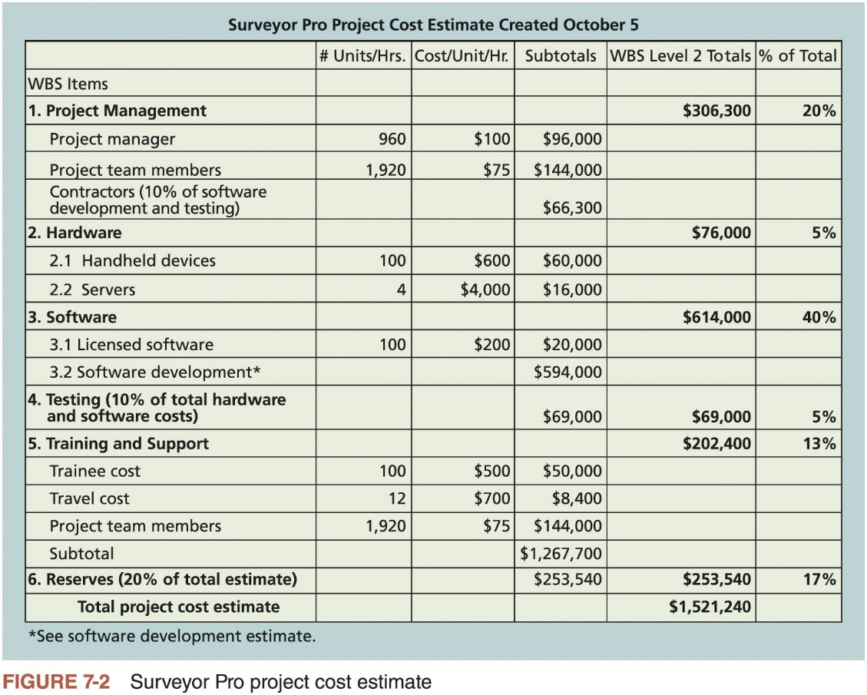
How to Develop a Cost Estimate and Basis of Estimates (2 of 3)

Slide 13
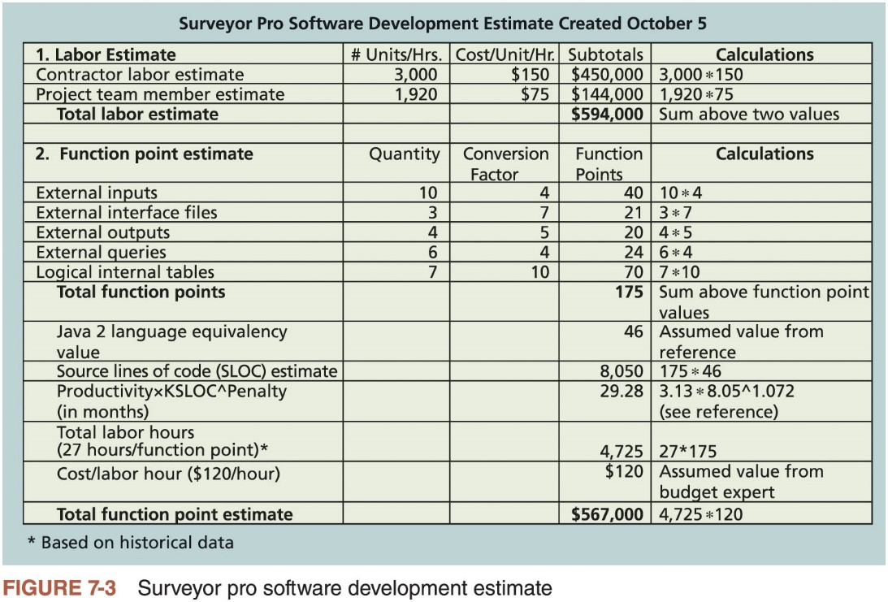
How to Develop a Cost Estimate and Basis of Estimates (3 of 3)

Slide 14
Determining the Budget (1 of 2)
Budgeting involves allocating the project cost estimate to individual work items over time
Material resources or work items are based on the activities in the WBS for the project
Important goal is to produce a cost baseline
Time-phased budget that project managers use to measure and monitor cost performance

Slide 15
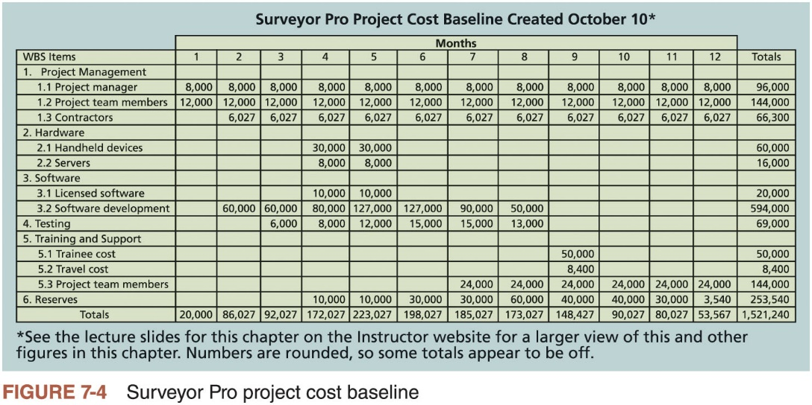
Determining the Budget (2 of 2)

Slide 16
Controlling Costs
Activities involved in controlling project costs
Measuring and monitoring cost performance
Ensuring that only appropriate project changes are included in a revised cost baseline
Informing project stakeholders of authorized changes to the project that will affect costs

Slide 17
Earned Value Management: a performance measurement technique (1 of 5)
Project performance measurement technique that integrates scope, time, and cost data
Given a baseline (original plan plus approved changes), you can determine how well the project is meeting scope, time, and cost goals
Earned value management involves calculating three values for each activity or summary activity from a project’s WBS
Planned value
Actual cost
Earned value

Slide 18

Earned Value Management (EVM)- M/C projects
EVM is a project performance measurement technique that integrates scope, time, and cost data
Given a baseline (original plan plus approved changes), you can determine how well the project is meeting its goals
You must collect the actual information periodically to use EVM
More organizations around the world are using EVM to help control project costs

Slide 19
Earned Value Management Terms
The planned value (PV), also called the budget, is that portion of the approved total cost estimate planned to be spent on an activity during a given period
Actual cost (AC), called actual cost of work performed, is the total of direct and indirect costs incurred in accomplishing work on an activity during a given period
The earned value (EV), is an estimate of the value of the physical work actually completed
EV is based on the original planned costs for the project or activity (budget) and the rate at which the team is completing work on the project or activity to date

Slide 20
EVM calculations
Rate of performance (RP) is the ratio of actual work completed to the percentage of work planned to have been completed at any given time during the life of the project or activity
Example
A project involved purchasing and installing a new web server. According to the budget , it would take one week and will cost a total of $10,000 (labour cost, hardware and software).
Planned Value (PV) = $10,000
Suppose the server installation was halfway completed by the end of week 1.
Rate of performance (RP) for first week = 50% (actual work completed)
Earned value (EV) for first week = $5000 (earned value estimate after one week) ➔
($10,000 * 50%) [EV = PV * RP]
It took two weeks and cost of $20,000 to purchase and install the new server. $15,000 of the cost was incurred in the first week and $5000 in the second week.
Actual cost (AC) for first week = $15,000
Cost variance (CV) for the first week = -$10,000 ➔ ($5000 - $15,000) [CV = EV – AC]
If CV is negative, it means performing the work costs more than planned
If CV is positive, it means performing the work costs less than planned
If CV = 0- no extra money is spent than what was allocated for the time period.

Slide 21
EVM calculations
Schedule Variance (SV) for the first week = -$5000 → ($5000 - $10,000) [SV = EV – PV]
If SV is negative, it means performing the work took longer than planned
If SV is positive, it means performing the work took less than planned
If SV is 0- work done within the allocated time period
Cost performance index (CPI) for first week = 33% ➔ (5000/15,000) * 100% → over the budget [CPI = (EV / AC) * 100]
If CPI is equal to 1 or 100%, it means that the cost incurred is what is in the budget
If CPI is less than 1 or less than 100%, it means that the project is over the budget
If CPI is greater than 1 or greater than 100%, it means that the project is under the budget
Schedule performance index (SPI) for first week = 50% → ($5,000/ $10000) * 100% ➔ behind the schedule ) [SPI = (EV / PV) * 100]
If SPI is equal to 1 or 100%, it means that the project so far is on schedule.
If SPI is less than 1 or less than 100%, it means that the project is behind the schedule
If SPI is greater than 1 or greater than 100%, it means that the project is ahead of schedule

Slide 22
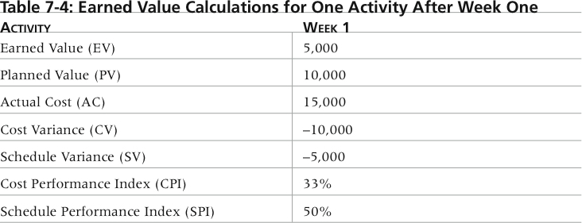
Table 7-4. Earned Value Calculations for One Activity After Week One

Slide 23
EVM calculations
Budget at Completion (BAC)
Suppose for a project, the total budget is $100,000 for 12 months.
BAC for the project is $100,000
Calculating the Estimate at Completion (EAC) after one week of project work
New estimated cost = $122, 308
For this project, CPI is 81.76%
EAC = (BAC/CPI) * 100
New estimated completion time = 13 months (after one week of project work)
For this project, the original time estimated was 12 months and SPI is 94.20
Original time/ SPI* 100

Slide 24
Earned Value Management (EVM)
Term | Formula
Earned value (EV) | EV = PV of all completed work
Cost variance (CV) | CV = EV - AC
Schedule variance (SV) | SV = EV - PV
Cost performance index (CPI) | CPI = EV/AC
Schedule performance index (SPI) | SPI = EV/PV
Estimate at completion (EAC) | EAC = BAC/CPI
Estimated to Complete (ETC) | ETC = EAC - AC
Table 7-4 Earned value formulas
BAC (Budget at completion): The original total budget

Slide 25
Global use of EVM
EVM is used worldwide, and it is particularly popular in the Middle East, South Asia, Canada, and Europe
Most countries require EVM for large defence or government projects, as shown in Figure 7-7
EVM is also used in private-industry sectors such as IT, construction, energy, and manufacturing.
However, most private companies have not yet applied EVM to their projects because management does not require it, feeling it is too complex and not cost-effective

Slide 26
Homework
Before next week’s class Chapter 11 Risk Management from Information Technology Project Management (2019) by Kathy Schwalbe

